Slide 1
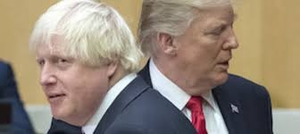
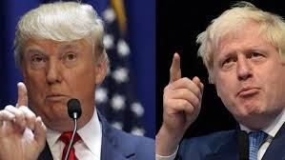
TRUMP AND BORIS, ARE THEY RELATED? Jer. 3:17; Zec. 14:9-10; [Dan. 2:41-43]

Slide 2
MY SOURCES;
Neil Wilson &Len Woods. Left behind; Armageddon, 2003. John Hagee. Jerusalem Countdown; A Warning to the World, 2006. Robert J. Wieland. The Revelation of Things to Come, 1998. H. L. Willmington. Willmington’s Guide to the Bible, 1984.
John Hagee. Four Blood Moons; Something is about to Change, 2013. Don E. Stanton. Israel; Nation of Destiny, 2002.
Fred Wright, Ed. Israel; His People, His Land, His Story, 2005. Guy P. Duffield and Nathaniel M. Van Cleave. Foundation of Pentecostal Theology, 2006. Tremper Longman III & David E. Garland. The Expositor’s Bible Commentary, 2007. John Hagee. Beginning of the END; The Assassination of Yitzhak Rabin and the Coming Antichrist, 1996.

Slide 3
SOME RAPTURE SCRIPTURE PASSAGES
Jn. 14:1-3; Rom. 8:19; 1Cor. 1:7-8; 15:51-53; 16:22; Phi.3:20-21; 4:5; Col. 3:4; 1Thess.1:10; 2:19-20; 4:13-18; 5:9,23;
2Thess. 2:1; 1Tim. 6:14; 2Tim. 4:1, 8; Tit. 2:13; Heb. 9:28;
Jam. 5:7-9; 1Pet. 1:7, 13; 5:4; 1Jn. 2:28-3:2-3; Jude 21;
Rev. 2:225; 3:10
SOME SECOND COMING SCRIPTURE PASSAGES
Dan. 2:44-45; 7:9-14; 12:1-3; Zech. 12:10; 14:1-4; Matt.
13:41; 24:15-31: 26:64; Mk. 13:14-27; 14:62; Lk. 21:25-28; Acts 1:9-11; 3:19-21; 1Thess 3:13; 2Thess. 1:6-10; 2:8; 1Pt. 4:12-13; 2Pt. 3:1-14; Jude 14-15; Rev. 1:7; 19:11-20:6; 22:7, 12, 20

Slide 4
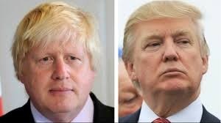
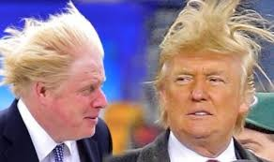
ARE TRUMP AND BORIS RELATED?
SECONDARY SIGNS

Slide 5
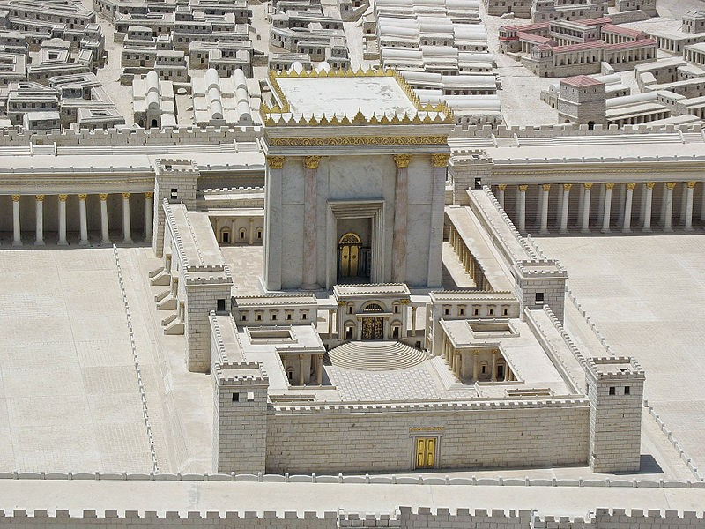
PROPHESY ON THE DESTRUCTION OF HEROD’S TEMPLE IN JERUSALEM (BY JESUS) Matt. 24:2

Slide 6
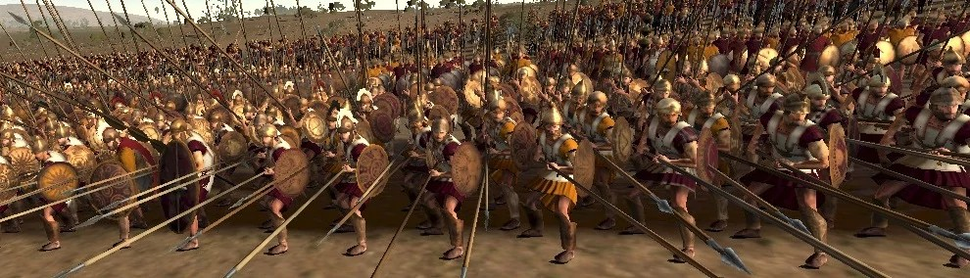
ROMAN SOLDIERS MARCHING TO JERUSALEM

Slide 7
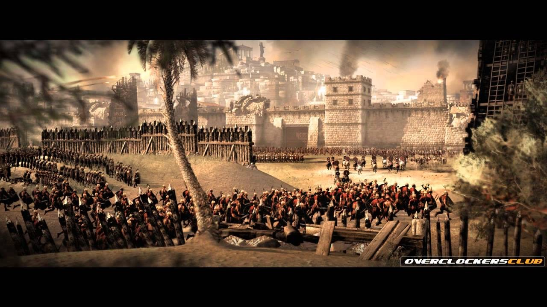
ROMAN SOLDIERS SURROUNDED JERUSALEM [Luk. 21:20]
When you see Jerusalem surrounded
By armies you know that the destruction
Has arrived

Slide 8
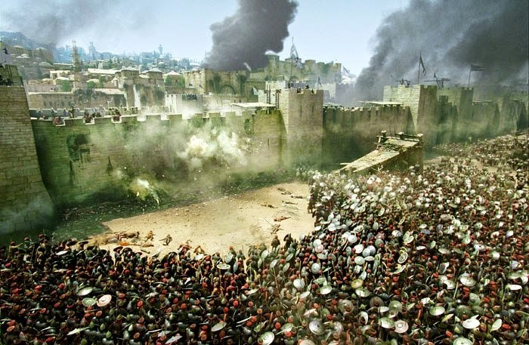
ROMAN SOLDIERS SURROUNDED JERUSALEM, LK. 21:24
They will be killed by the Sword and taken away into Captive to all the nations of the
world

Slide 9
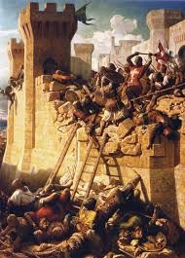
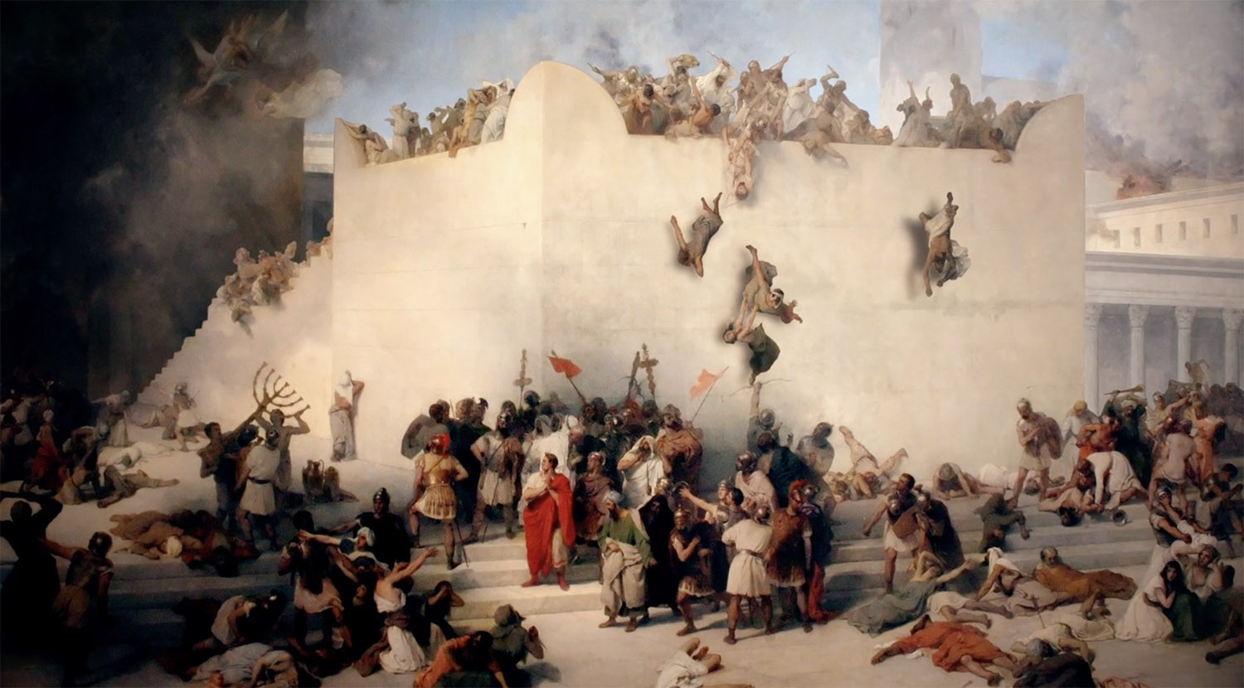
DESTRUCTION OF JERUSALEM

Slide 10
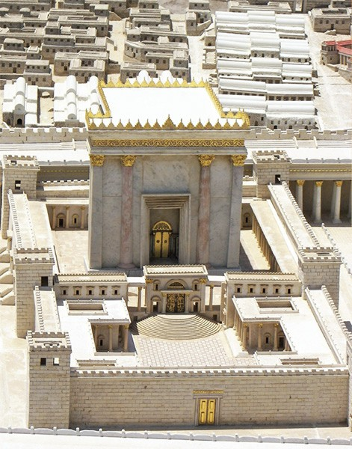
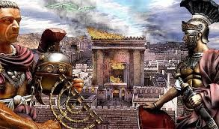
THE TEMPLE SET ON FIRE
HEROD’S TEMPLE

Slide 11
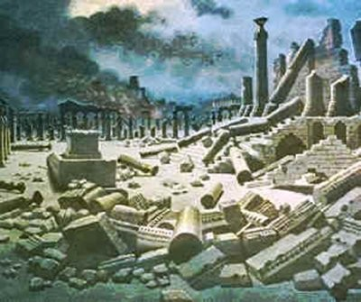
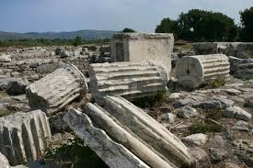
DESTROYED JERUSALEM TEMPLE, MATT. 24:2. NO STONE WOULD BELEFT ON ANOTHER.
Not one stone will be left on another
Not one stone will be left on another

Slide 12
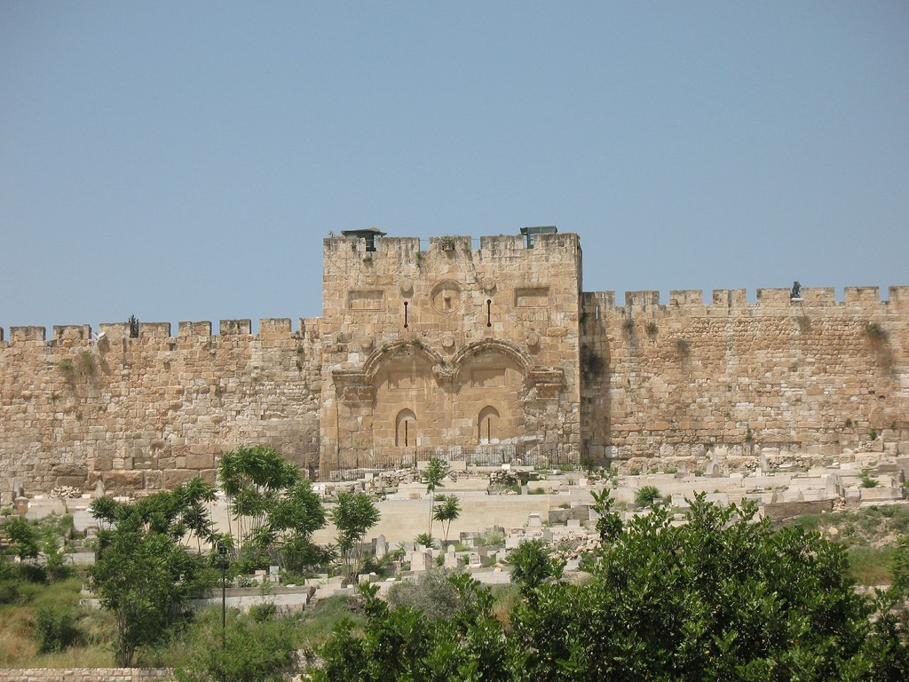
THE GOLDEN OR THE EASTERN GATE
EZE. 44:1-2; EZE. 43:1-4
2100years after Ezekiel’s prophesy
8 gates in Modern Jerusalem, seven are in use 1 is shut. 2600 years after Ezekiel’s prophesy

Slide 13
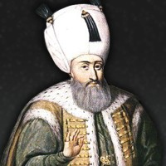
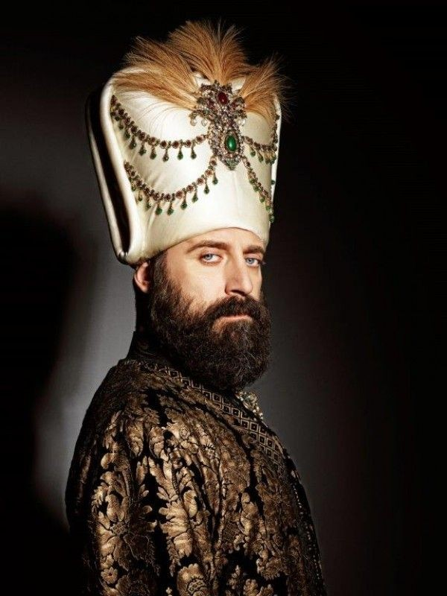
SULEMAN THE MAGNIFICENT (EMPRIOR)

Slide 14
In an attempt to prevent the Messiah entry through the Gate, a body was buried directly in front of it, to defile the Jewish Holy man if he attempts to enter through the gate
There are eight gates in modern Jerusalem, but only seven are open. Except The Eastern Gate just as Ezekiel prophesied IS CLOSED.
Miraculously the Eastern Gate has survived for nearly 500 years of numerous well-documented attempts to open it.
Four attempts to open the sealed Eastern Gate in recent years have all failed...
The Eastern Gate was shut with concrete, in AD 1540–41 by the order of Suleiman the Magnificent, [the Ottoman Empire]. The reasons for this remain unclear.
What He did, had fulfilled a prophecy by Ezekiel in around 600 BC, over 2,100 years before Suleiman actually shut the gate (Ezekiel 44:1-2)
It seems the Muslim leader [Suleiman] might be aware of the prophecy that had predicted the Messiah’s entrance through the Eastern Gate

Slide 15
The first attempt was on December 9th 1917 during the Battle of Jerusalem. Muslim leaders wanted to open The Eastern Gate and to seal the remaining gates in Jerusalem to prevent the invading Army led by the British entry.
The British took over the city and the gate remained sealed as Ezekiel had prophesied. Eze. 44:1
The second attempt was In 1967 when King Hussein of Jordan, decided to open the Eastern gate for Moslem worshippers, because he was going to build a hotel for Arab pilgrims at Magreb Gate, to block off Jewish worship forever.
But, on June 5th of 1967, as the workmen prepared to knock down the Gate an Israeli aircraft flew overhead which Begun The Six Day War, At the end of the Six Day War, (the Jews had managed to recapture Old Jerusalem.)

Slide 16
Third attempt was During the Six Day War the Jewish military suggested to attack the Jordanian Army by blowing through the sealed Eastern Gate. But the COMMANDER of the group, stopped them stating that “the Eastern Gate can only be opened when the Messiah comes.”
The fourth attempt was in October 31 of 1997 "Israel's Housing Ministry wanted to reopen the sealed gate and to build more Jewish settlement.
But the Palestinians opposed it."
The gate will remain shut until the return of the Lord as this prophecy reaches its fulfillment

Slide 17
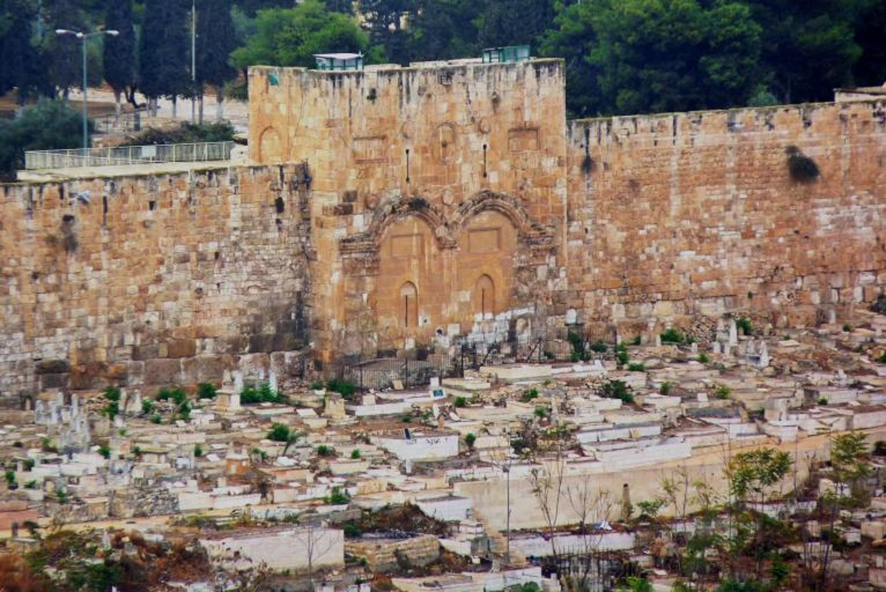
CEMETERY BEHIND THE EASTERN GATE [Eze. 44:1-3]

Slide 18
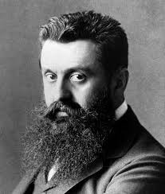
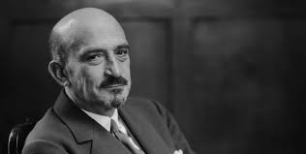
DR HERZL (Zionist movement) DR WEIZMAN [Regathering of the Jewish people to their land]

Slide 19
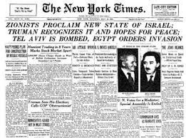
U.N.O. DECLEARED ISRAEL AS A SOVEREIGN STATE

Slide 20
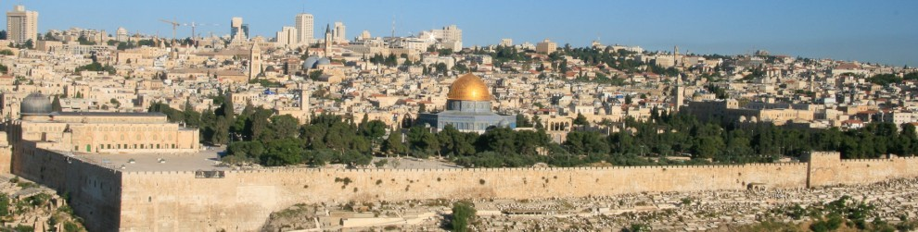
Birth of JERUSALEM [Isa. 66:8-12]
Can a Nation be born in a Day…

Slide 21
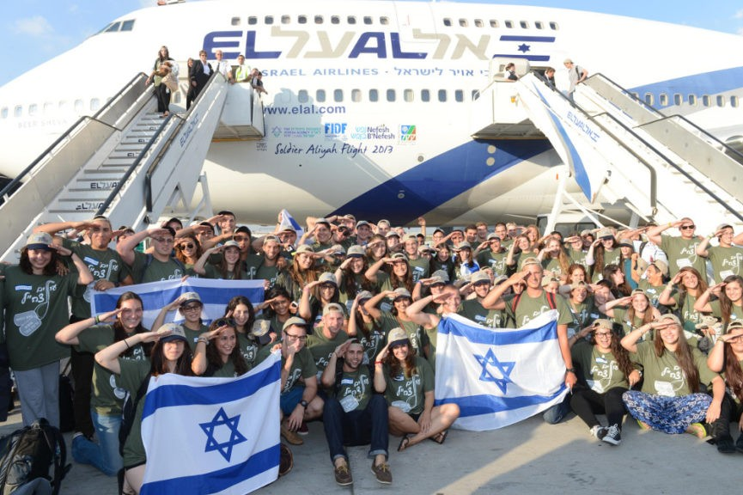
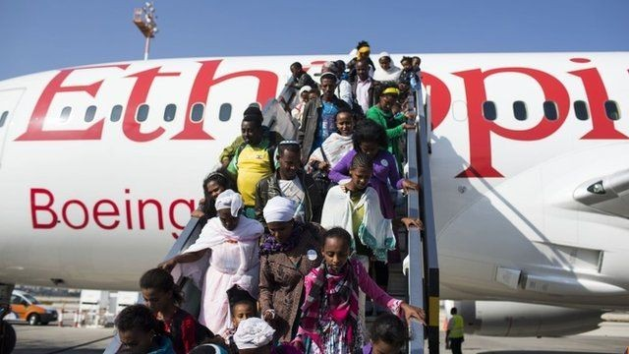
Secondary sign, Return of Israel to their land. Isa. 60:8-11; Jer. 23:7-8 (…people will not say…)

Slide 22
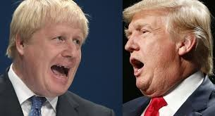
TRUMP AND BORIS, ARE THEY RELATED? Jer. 3:17; Zec. 14:9-10; [Dan. 2:41-43]

Slide 23
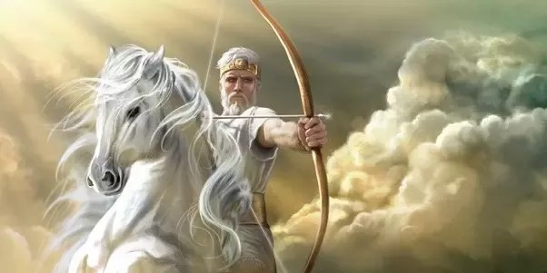
1st THE WHITE HORSE WHO CONQUERED (DECEPTION)
REV. 6:2, Matt. 24:5-6, 11 _{SPIRIT OF DECEPTION}

Slide 24
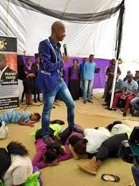
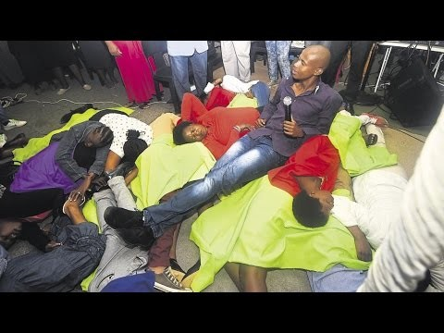
FALSE PROPHETS

Slide 25
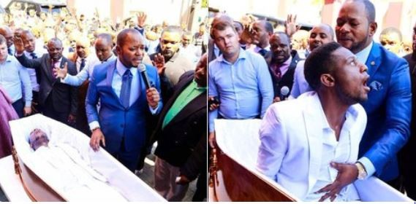
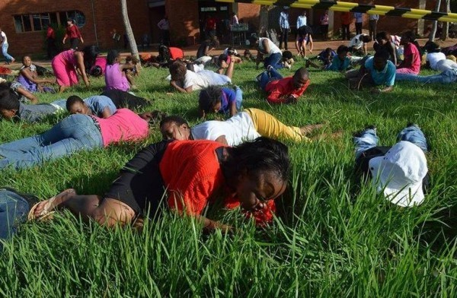
FALSE PROPHETS

Slide 26
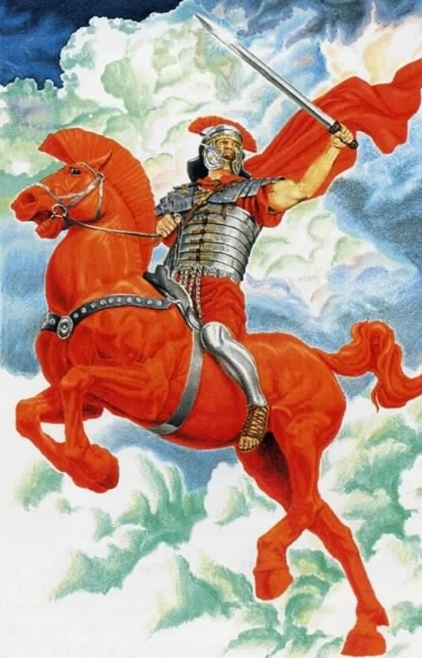
2nd RED HORSE, WHO IS TO TAKE AWAY PEACE FROM THE EARTH AND CAUSE MEN TO KILL THEMSELVES
REV. 6:3-4

Slide 27
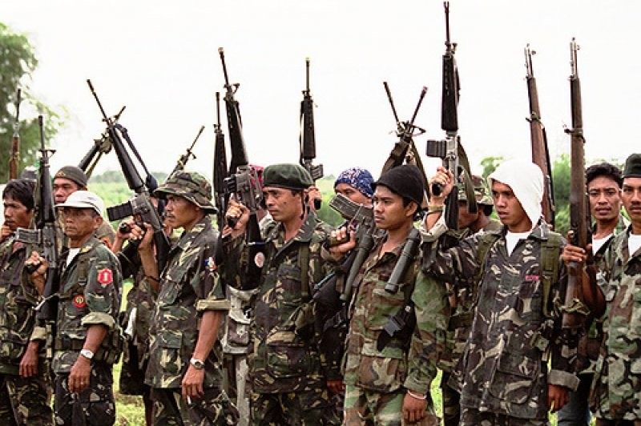
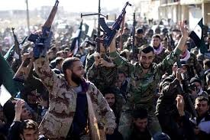
PEACE IS TAKEN AWAY FROM THE WORLD

Slide 28
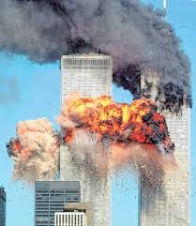
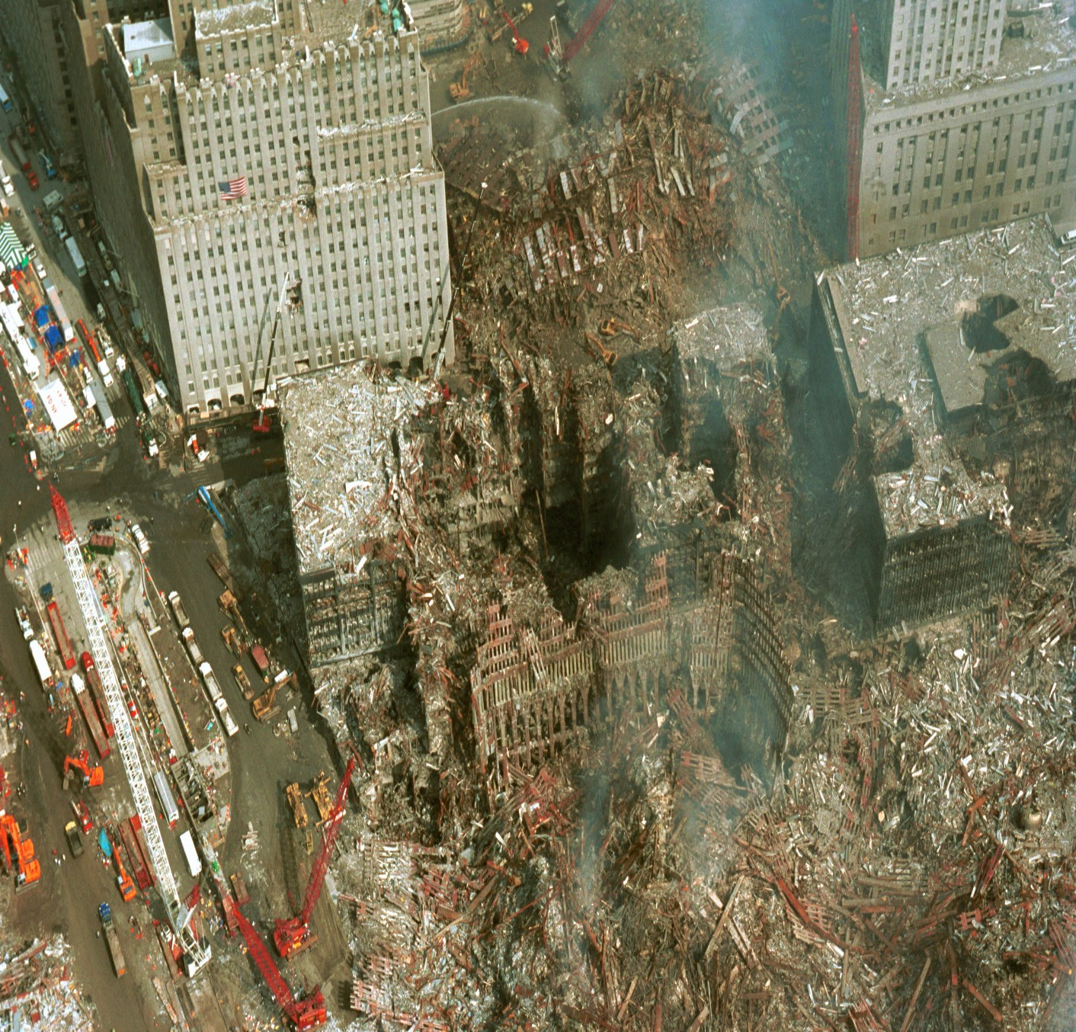
9/11 TWIN TOWER SUICIDE BOMBING

Slide 29
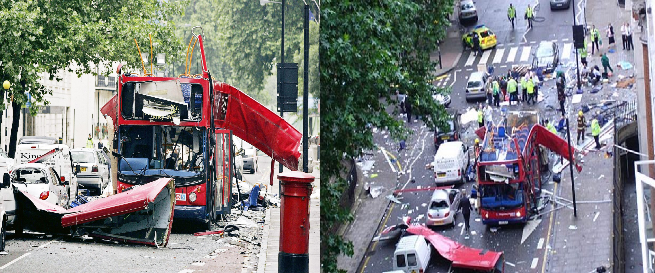
7/7 LONDON BOMBING

Slide 30
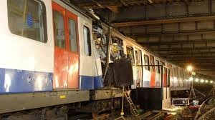
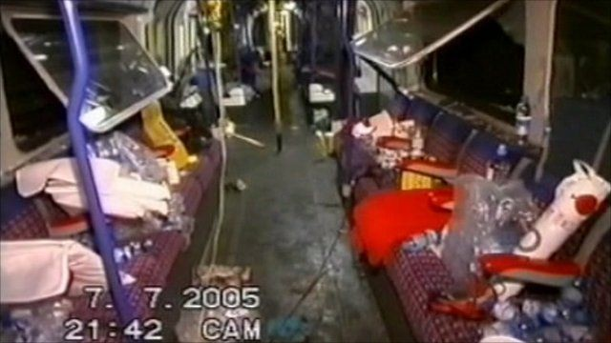
7/7 LONDON UNDERGROUND BOMBING

Slide 31
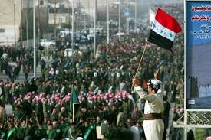
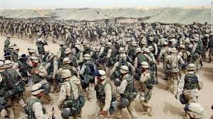
IRAQI ARMY
AMERICAN ARMY

Slide 32
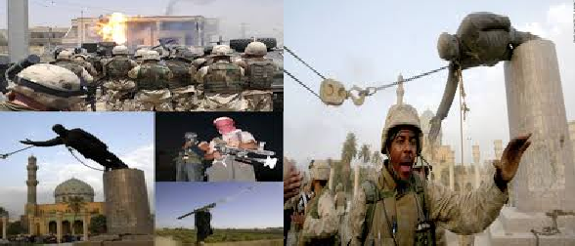
WARS AND RUMOURS OF WARS [Matt. 24:6]

Slide 33
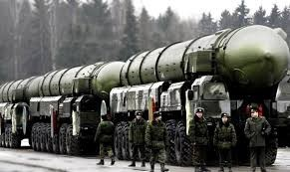
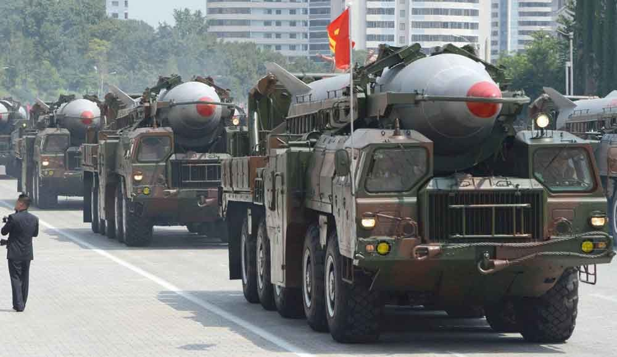
AMERICAN WEAPONS VRS NORTH KOREA WEAPONS

Slide 34
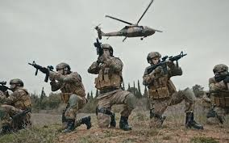
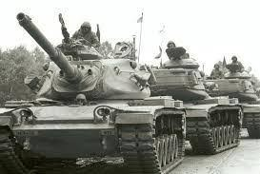
Matt. 24:6
WARS AND RUMOURS OF WAR

Slide 35
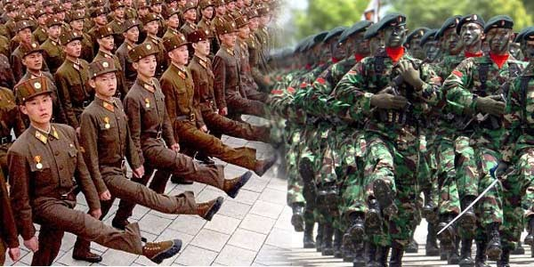
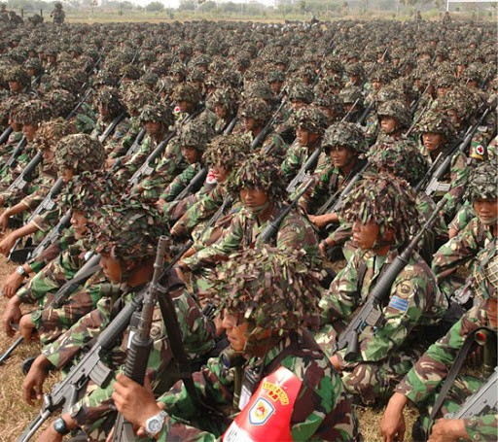
WARS AND RUMOURS OF WAR; INDONESIA VRS MALAYSIA Matt. 24:6

Slide 36
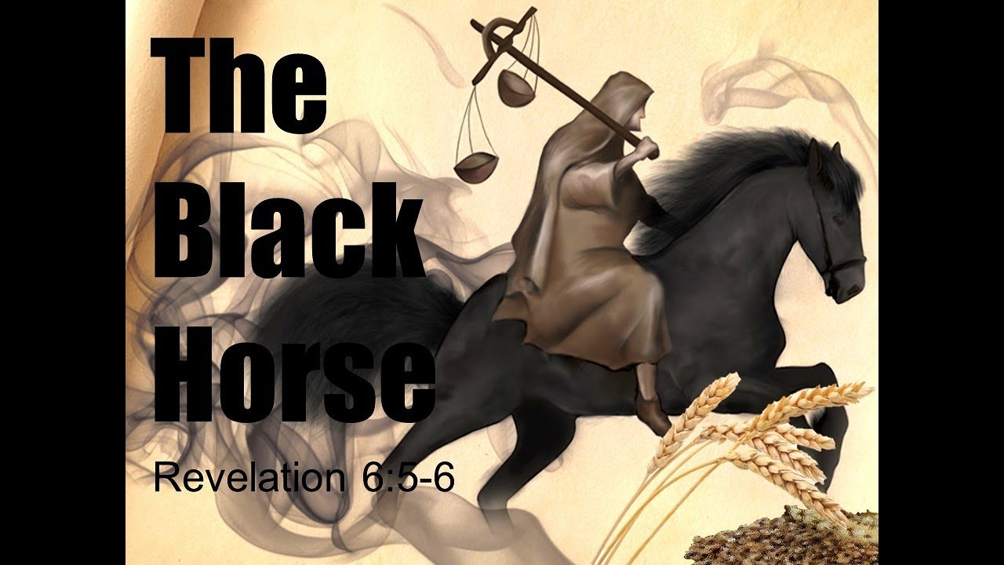
3rd THE ANGEL OF FAMINE AND HIGH FOOD PRICES
REV. 6:7b

Slide 37
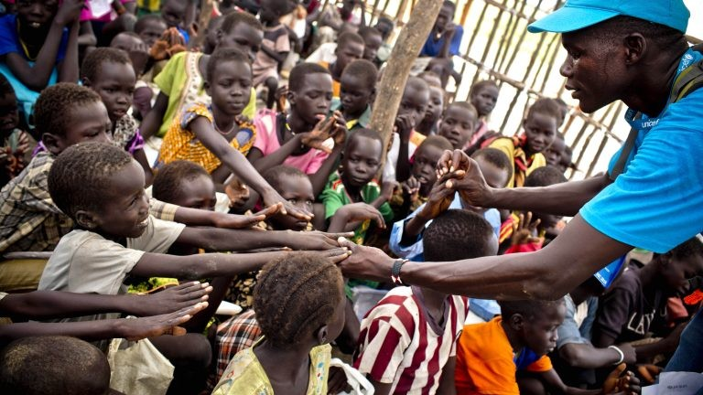
SOUTHERN SUDAN FAMINE. [Matt. 24:7b] REV. 6:7b

Slide 38
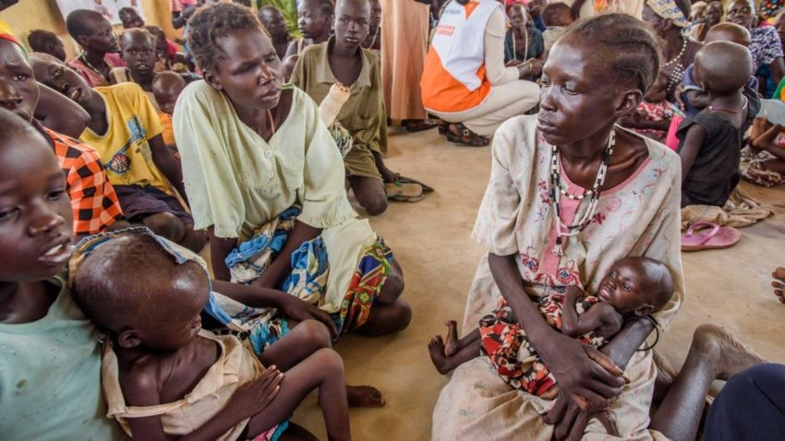

REFUGEE CAMPS in AFRICA and PAKISTAN.
Matt. 24:7b

Slide 39


SOUTHERN SUDAN Matt. 24:7b REFUGEE CAMP

Slide 40


4th PALE HORSE, ONE WHO KILLS ¼ OF THE POPULATION
REV. 6:9b

Slide 41



NAZI MASACRE CAMP. [REV. 6:9b; Matt. 24:9a]
HOLOCAUST MASACRE. [REV. 6:9b; Matt. 24:9a]

Slide 42

KOSOVO MASACRE. [REV. 6:9b; Matt. 24:9a]

Slide 43




EARTHQUAKES [Matt. 24:7b]
INDONESIA and JAPAN [Matt. 24:7b]

Slide 44

[REV. 6:9-10]
CHRISTIANS WHO WERE KILLED.
5th Seal

Slide 45


THE 5TH SEAL, THOSE KILLED FOR THEIR FAITH CRYING FOR VENGENCE, Rev. 6:9-11

Slide 46
TRUMP AND BORIS, ARE NOT RELATED?

Slide 47






Secondary signs;
INSTANT COMMUNICATION
FAST TRANSPORTATION
CHIP IMPLANT

Slide 48
Biohax, a Swedish microchip company, is discussing with UK
companies to supply
The main benefit of the procedure seems to be its’ convenience.
The microchip implant essentially serves as an internal-employee-identification badge —
The chips can be used to grant access to buildings and to pay for things around the office like food or print jobs.
They can also be used to restrict access to certain off- limits areas.

Slide 49

Secondary sign (All eyes will see)

